Slide 1

Launch Ad

Slide 2
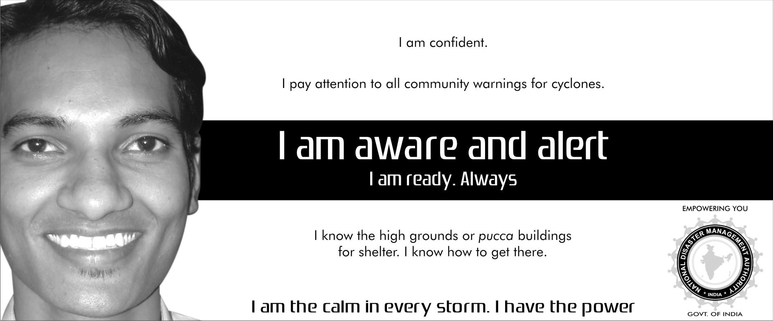
Ad1 60 CC

Slide 3
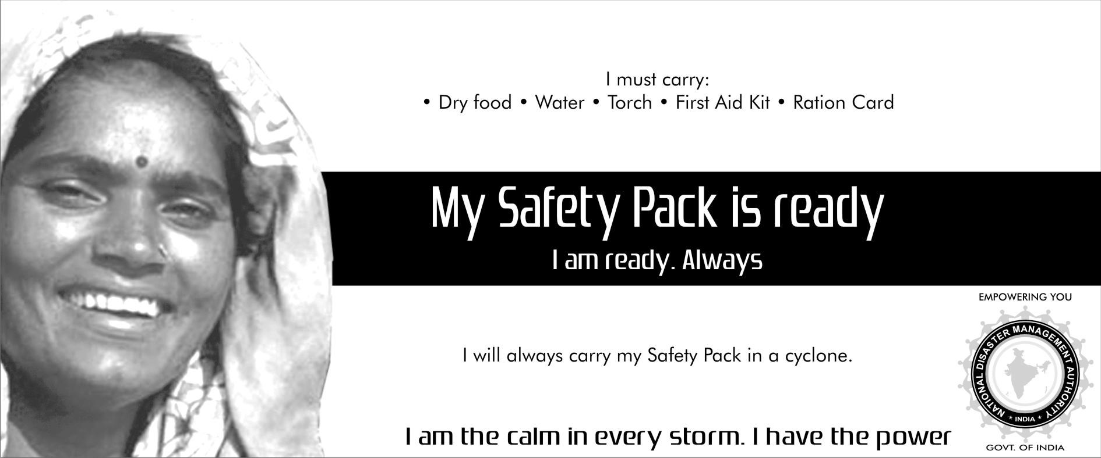
Ad2 60 CC

Slide 4
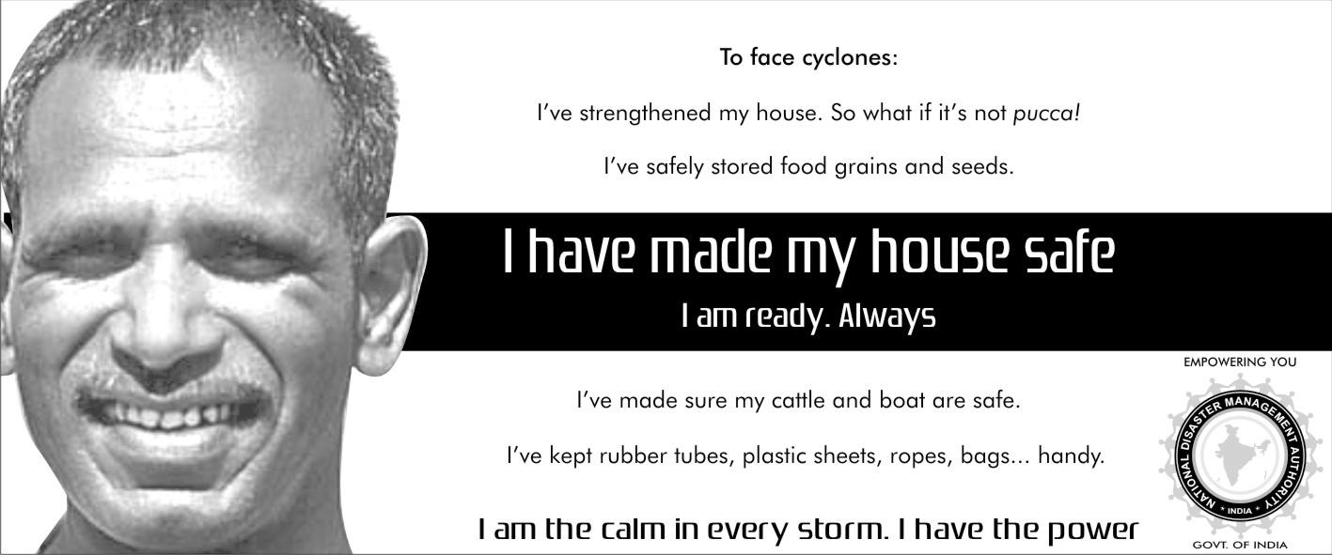
Ad3 60 CC

Slide 5
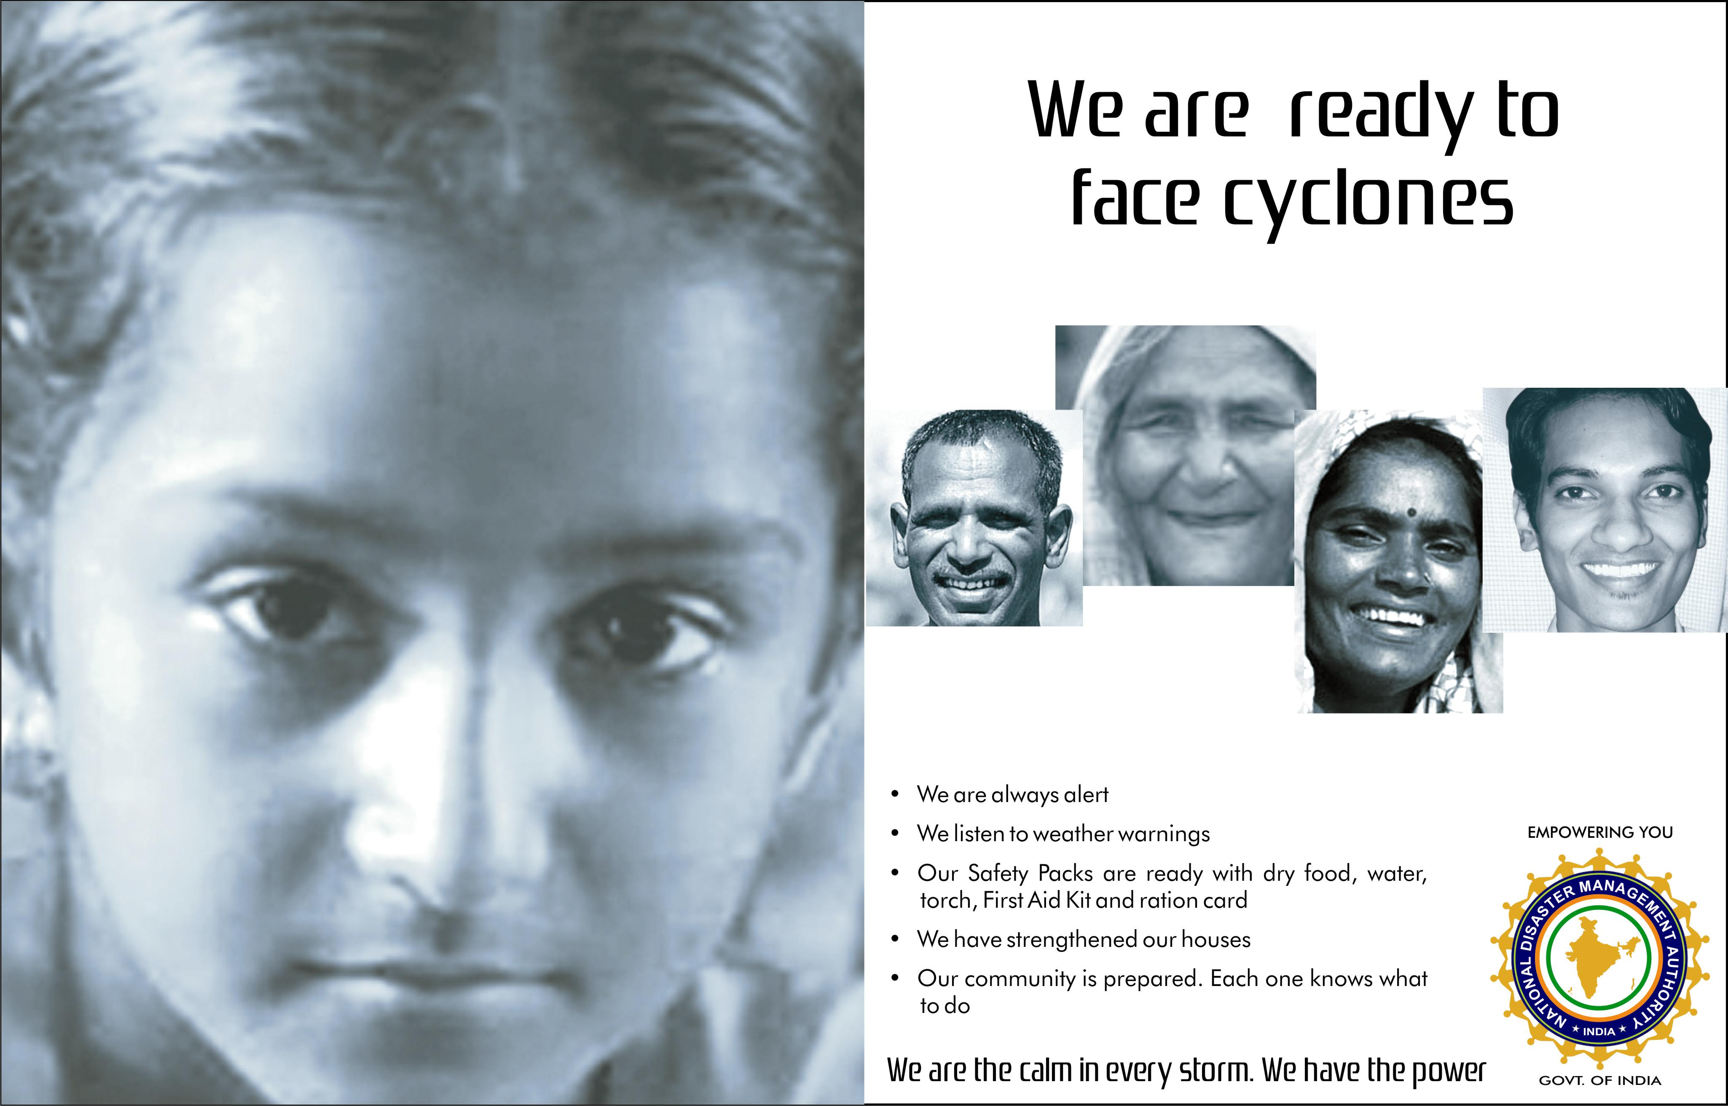
Half Page Ad1

Slide 6
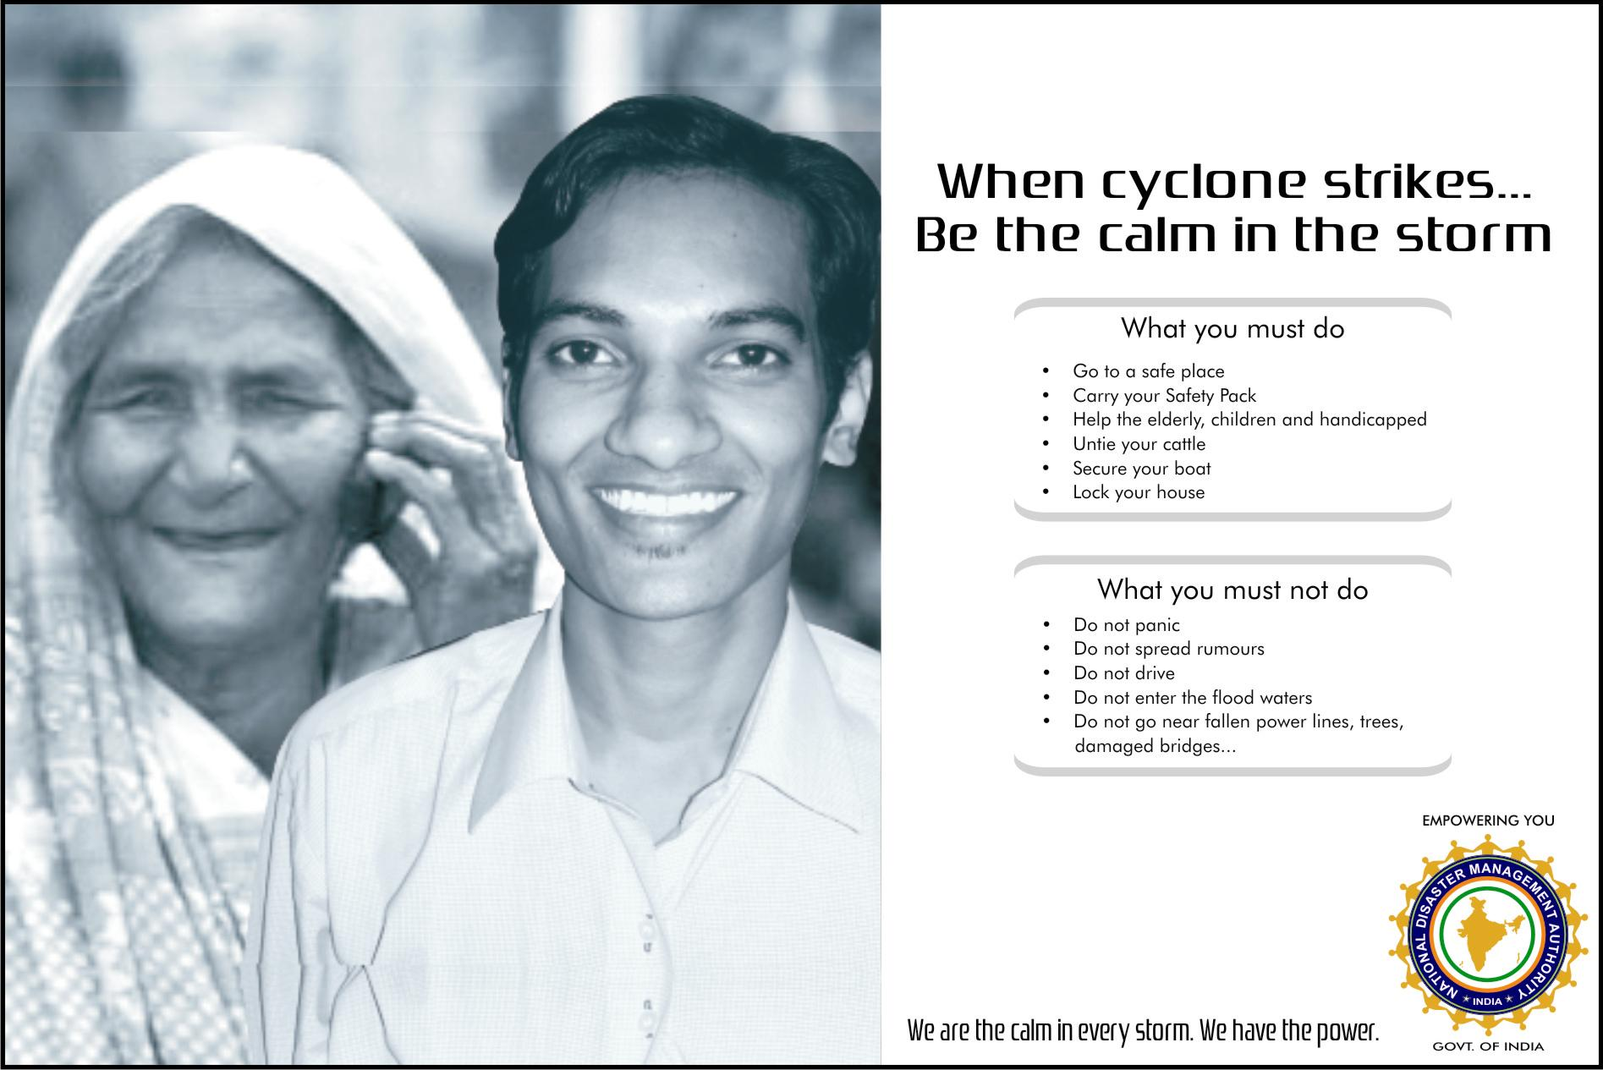
100 CC Ad

Slide 7

Half Page Ad 2

Slide 8

80 CC Ad

